Slide 1

AZURE ADMINISTRATOR ASSOCIATE
24CC3046
TEAM MEMBERS:
2400031666 - Urmi Bera
2400031666 - K.Eswar

Slide 2
AZURE AUTOMATION RUNBOOKS FOR VM START AND STOP SCHEDULES
Use Cases
  Shut down non-production VMs outside business hours.
  Cut the test environment bill by half.
Bottlenecks Students May Encounter
  Runbook failures go unnoticed without alerting.
  Managed Identity permissions are over-scoped for convenience.

Slide 3
PROJECT OVERVIEW
Project Title: Azure Automation Runbooks for VM Start and Stop Schedules
Overview
  Automates the starting and stopping of Azure Virtual Machines (VMs).
  Uses Azure Automation Account to manage and execute runbooks.
  Uses PowerShell scripts to control VM operations.
  Schedules VMs to start before working hours and stop after working hours.
  Uses Managed Identity for secure authentication.
  Helps reduce unnecessary cloud computing costs.
Key Benefits
  Reduced manual effort.
  Improved resource management.
  Automated VM scheduling.
  Cost optimization for non-production environments.

Slide 4
PROBLEM STATEMENT
Problem Statement
  Azure Virtual Machines are often left running outside business hours.
  Continuous operation leads to unnecessary cloud computing costs.
  Manually starting and stopping VMs requires time and effort.
  Forgetting to shut down unused VMs increases expenses.
  Lack of automated scheduling makes resource management difficult.
Proposed Solution
Implement Azure Automation Runbooks using PowerShell scripts to automatically start and stop VMs according to predefined schedules.
Expected Benefits
  Reduce unnecessary VM running time.
  Minimize manual intervention.
  Improve resource utilization.
  Optimize cloud costs.

Slide 5
OBJECTIVES
Main Objectives
  Automate the starting and stopping of Azure Virtual Machines.
  Create PowerShell Runbooks for VM management.
  Configure automatic schedules for working hours.
  Use Managed Identity for secure authentication.
  Assign appropriate permissions using Azure RBAC.
  Monitor runbook execution and detect failures.
  Reduce unnecessary cloud computing costs.
  Improve resource management and operational efficiency.

Slide 6
USE CASE / REAL-WORLD SCENARIO
Scenario: College Computer Lab
A college uses Azure Virtual Machines for student programming and development activities.
Existing Problems
  VMs remain running even when students are not using them.
  Cloud computing costs increase due to idle resources.
  Administrators must manually start and stop VMs.
Proposed Solution
Use Azure Automation Runbooks to automatically manage VM operating hours
.
Example Schedule
Day Monday–Friday Saturday–Sunday
Start Time 8:00 AM No scheduled start
Stop Time 7:00 PM No scheduled stop
Benefits
  Automatic VM availability during lab hours.
  Reduced manual effort.
  Lower unnecessary compute costs.
  Improved cloud resource management.

Slide 7
AZURE SERVICES USED
1. Azure Virtual Machines (VMs)
  Provides cloud-based computing resources.
  Runs applications and workloads.
  Can be started and stopped automatically.
2. Azure Automation Account
  Stores and manages automation runbooks.
  Executes PowerShell scripts.
  Supports scheduled automation.
3. Azure Managed Identity
  Provides secure authentication.
  Eliminates the need to store credentials in scripts.
4. Azure Role-Based Access Control (RBAC)
  Assigns permissions to the Automation Account.
  Controls access to VM resources.
5. Azure Monitor
  Tracks automation execution and resource activity.
  Helps detect failures and configure alerts.
Technologies Used
  PowerShell
  Azure PowerShell Modules (Az.Accounts, Az.Compute)
  Azure Automation Schedules

Slide 8
SOLUTION ARCHITECTURE
1. Azure Automation Account
  Manages runbooks and schedules.
  Executes automation tasks.
2. Managed Identity
  Authenticates securely with Azure.
  Provides access to VM resources.
3. Start VM Runbook
  Starts the VM at the scheduled time.
  Uses PowerShell commands.
4. Stop VM Runbook
  Stops and deallocates the VM.
  Reduces unnecessary compute usage.
5. Azure Virtual Machine
  Runs during scheduled working hours.
  Stops automatically after working hours.
6. Azure Monitor
  Tracks job execution.
  Helps identify failures
Workflow
Azure Automation Account → Managed Identity → Start/Stop Runbooks → Azure Virtual Machine → Monitoring and Job History

Slide 9
AZURE RESOURCE CONFIGURATION
Resource Example Name
Resource Group RG-Automation
Virtual Machine TestVM01
Automation Account VM-Automation-Account
Start Runbook Start-VM-Runbook
Stop Runbook Stop-VM-Runbook
Start Schedule Weekday-VM-Start
Stop Schedule Weekday-VM-Stop
Configuration Steps
  Create a Resource Group in Azure.
  Create or select a Virtual Machine.
  Create an Automation Account.
  Enable Managed Identity.
  Assign the required permissions.
  Create the Start and Stop Runbooks.
  Configure the automation schedules.
Expected Outcome
All required Azure resources are configured and ready for automated VM management.

Slide 10
IMPLEMENTATION APPROACH
1. Azure Resource Setup
Create a Resource Group, Virtual Machine, and Automation Account.
2. Security Configuration
Enable Managed Identity and assign permissions using Azure RBAC.
3. Runbook Development
Create PowerShell Runbooks to start and stop the VM.
4. Testing and Validation
Execute runbooks manually and verify VM status.
5. Scheduling
Configure automatic start and stop schedules for working hours.
6. Monitoring
Track job execution and troubleshoot failures using Azure monitoring tools.

Slide 11
CONFIGURATION & DEPLOYMENT
Configuration
  Create and configure the Azure Automation Account.
  Enable Managed Identity and assign required permissions.
  Configure PowerShell modules and runbook parameters.
  Save and publish both runbooks.
Deployment
  Link the Start Runbook to the morning schedule.
  Link the Stop Runbook to the evening schedule.
  Set the time zone and recurring weekdays.
  Verify the schedules and monitor job execution.

Slide 12
SECURITY & ACCESS MANAGEMENT
Security Features
  Managed Identity: Provides secure authentication without storing credentials.
  Azure RBAC: Controls access to VM resources.
  Least Privilege: Grants only the permissions required for automation.
  Access Control: Restricts unauthorized access to runbooks and schedules.
  Monitoring: Tracks execution and helps identify failures.
Permission Used
- Virtual Machine Contributor: Allows the Automation Account to manage VM operations within the assigned scope.
Expected Outcome
Secure and controlled automation of VM start and stop operations.

Slide 13
NETWORKING CONFIGURATION
Networking Setup
  Virtual Network (VNet): Provides a secure network environment for the VM.
  Subnet: Organizes and isolates network resources.
  Network Security Group (NSG): Controls inbound and outbound traffic.
  Public IP (Optional): Enables external connectivity when required.
  Azure Resource Manager: Allows runbooks to manage VM operations securely.
Key Benefits
  Secure network communication.
  Controlled access to VM resources.
  Improved network isolation and security.

Slide 14
STORAGE CONFIGURATION
Storage Components
  OS Disk: Stores the VM's operating system and system files.
  Data Disk: Stores application data and user files.
  Managed Disks: Provide persistent storage for Azure VMs.
  Backup: Helps protect data and supports recovery.
Storage Considerations
  Storage remains available when a VM is stopped and deallocated.
  Disk storage may continue to incur charges even when the VM is stopped.
  Regular backups help prevent data loss.

Slide 15
MONITORING & MANAGEMENT
Monitoring Tools
  Azure Automation Jobs: Tracks runbook execution and status.
  Job Output: Displays execution messages and results.
  Job Errors: Helps identify failures and troubleshoot issues.
  Azure Monitor: Supports monitoring and alert configuration.
  Action Groups: Sends notifications when configured alerts are triggered.
Monitoring Process
  Check runbook job status.
  Review execution output and errors.
  Verify the VM's actual status.
  Resolve failures and monitor subsequent executions.

Slide 16
TESTING, VALIDATION, CHALLENGES & SOLUTIONS
Testing & Validation
  Execute the Start Runbook and verify that the VM starts successfully.
  Execute the Stop Runbook and confirm that the VM is deallocated.
  Verify Managed Identity authentication and permissions.
  Check schedule execution and job history.
Challenges & Solutions
  Authentication Errors: Configure Managed Identity correctly.
  Permission Issues: Assign appropriate Azure RBAC roles.
  Missing PowerShell Modules: Install required Az modules.
  Schedule Failures: Verify schedule settings and runbook publication.

Slide 17
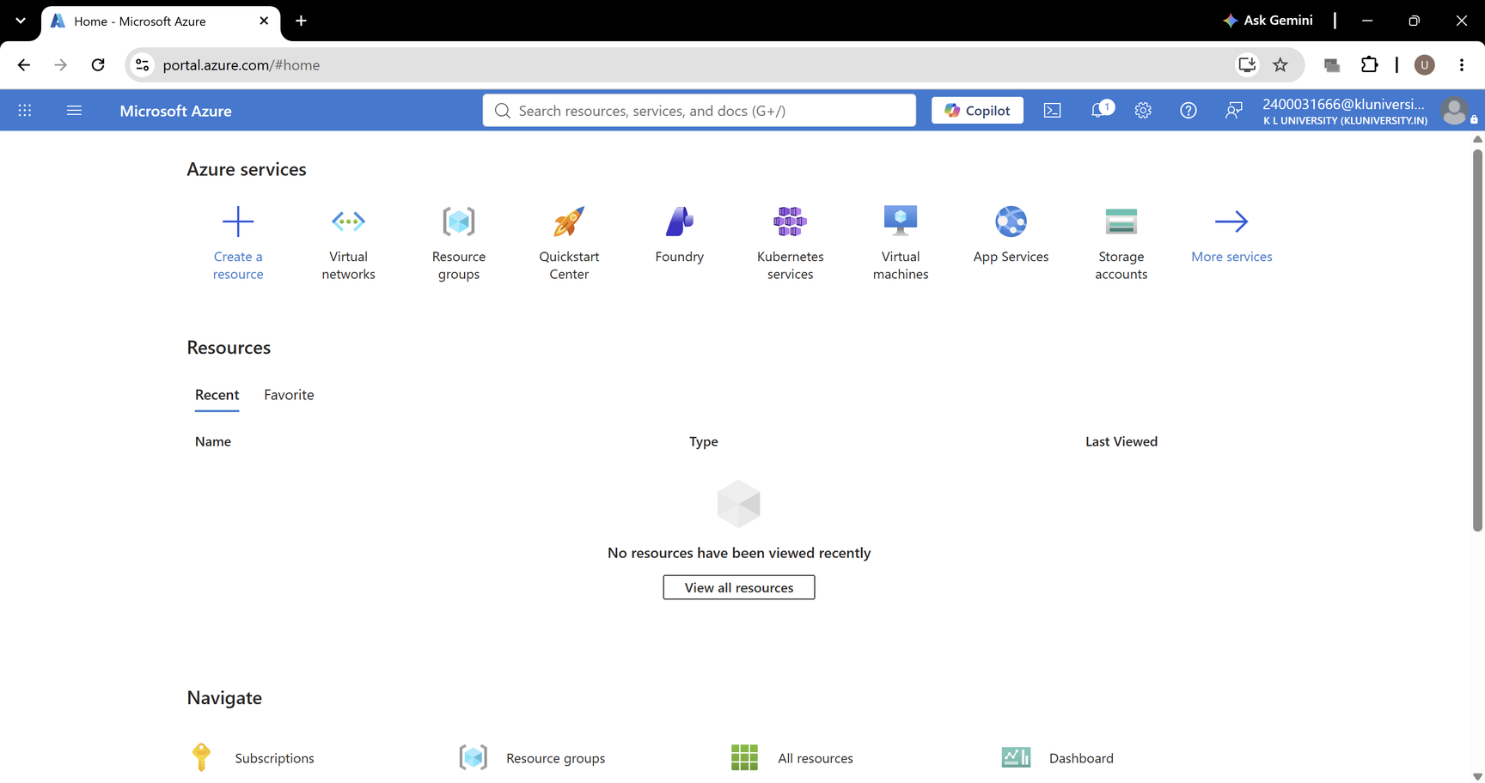
PROCESS & RESULTS
STEP 1: open azure portal

Slide 18
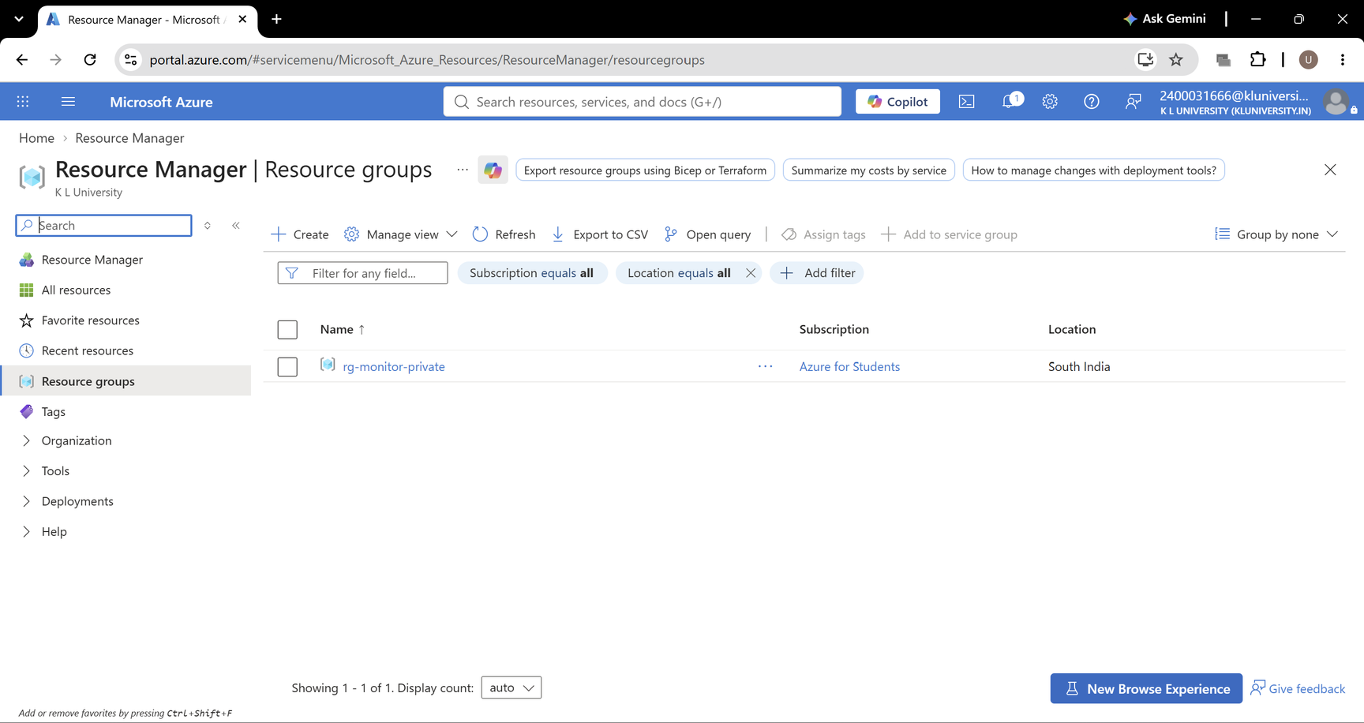
STEP 2: Create a Resource Group
A Resource Group is a folder that holds all your project resources.

Slide 19
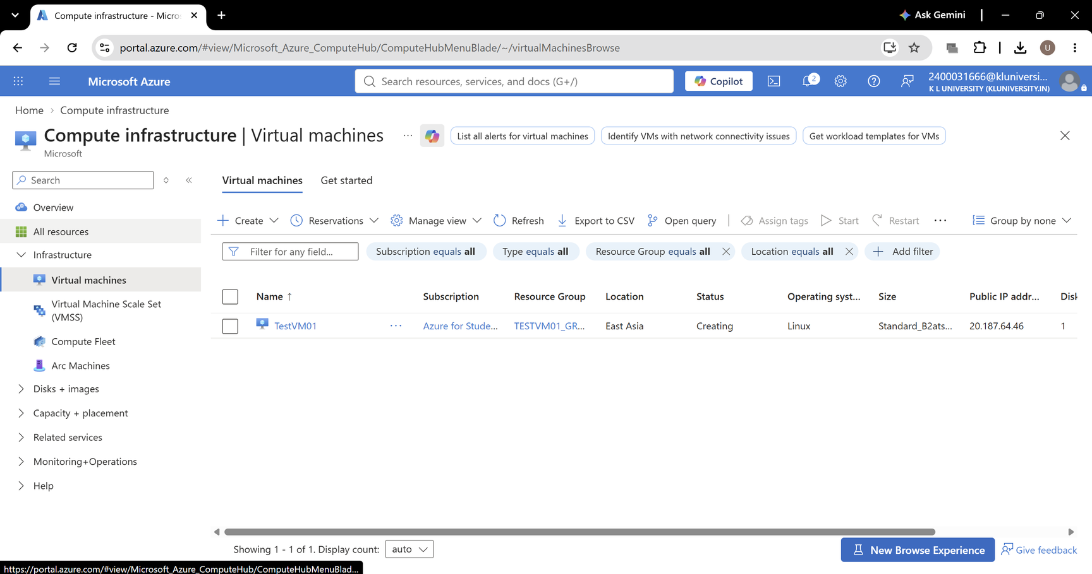
STEP 3: Create a Virtual Machine
A Virtual Machine (VM) is the computer we want to start and stop automatically.

Slide 20
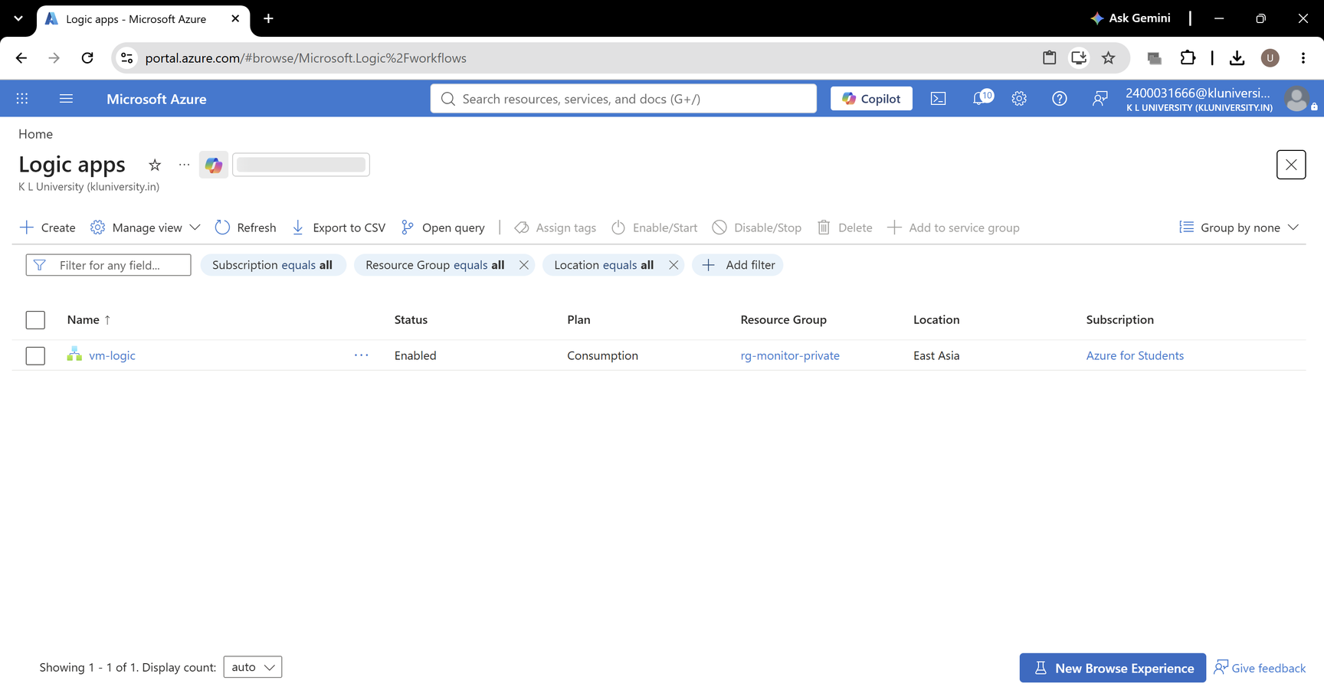
STEP 4: Create logic apps

Slide 21
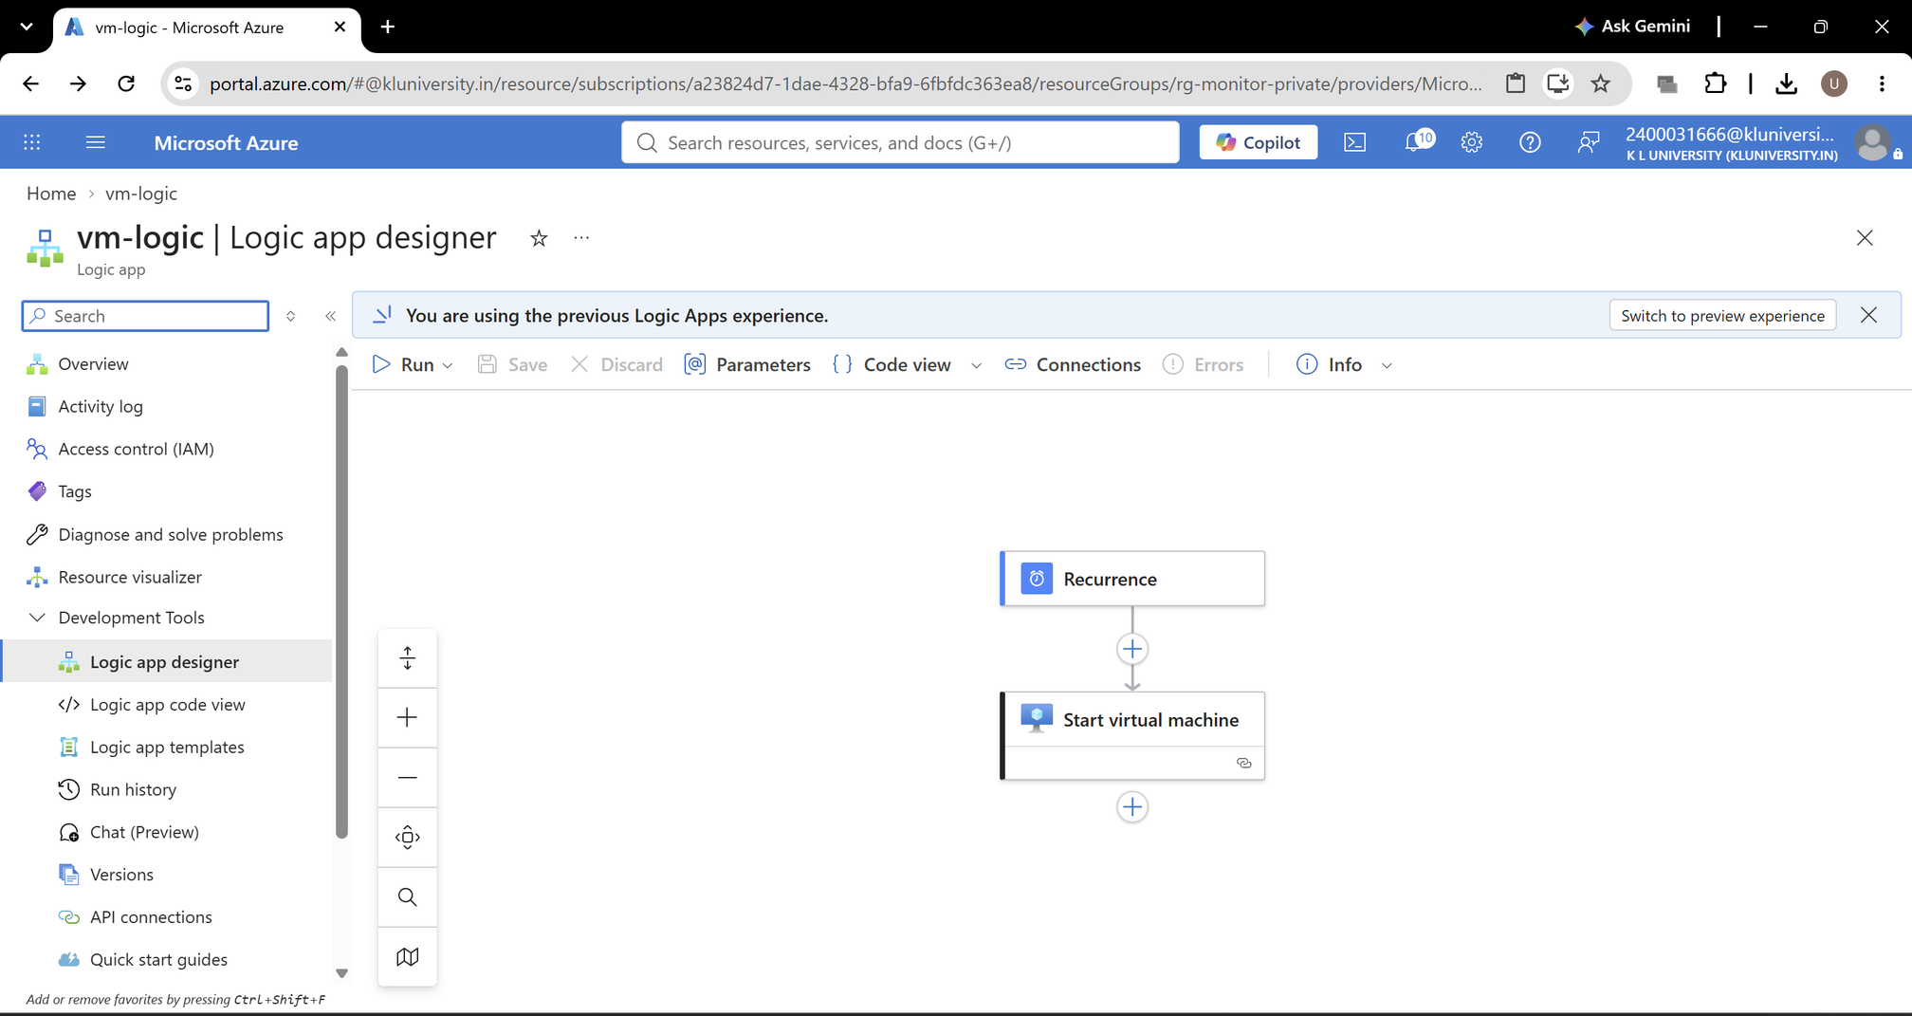
STEP 5: Create start virtual machine in logic apps

Slide 22
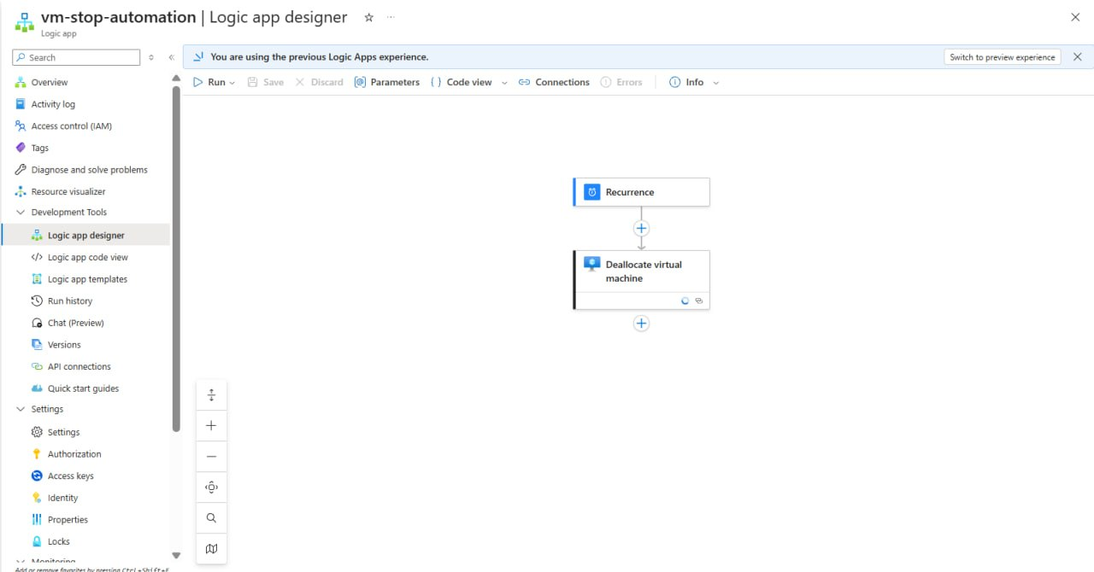
STEP 6: Create Stop Virtual Machine in logic apps

Slide 23
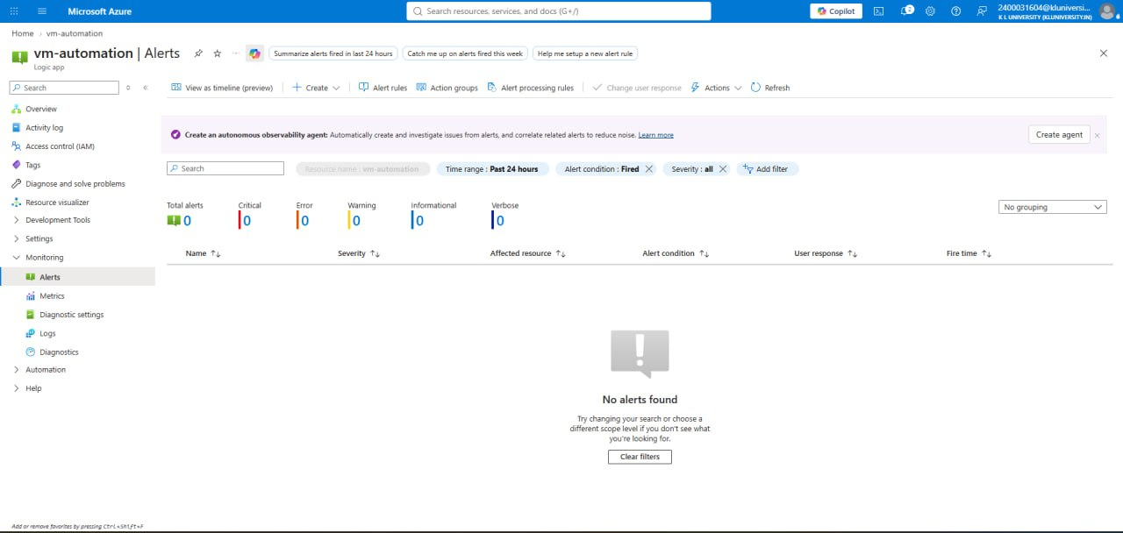
STEP 7: Start VM Failure Alert Monitoring

Slide 24
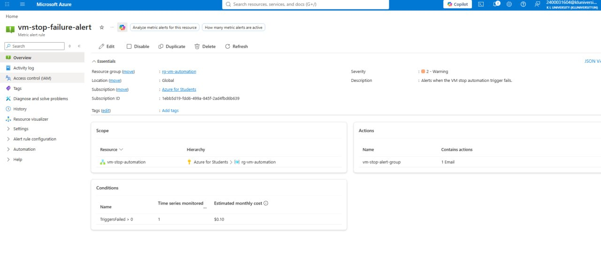
STEP 8: Stop VM Failure Alert Monitoring

Slide 25
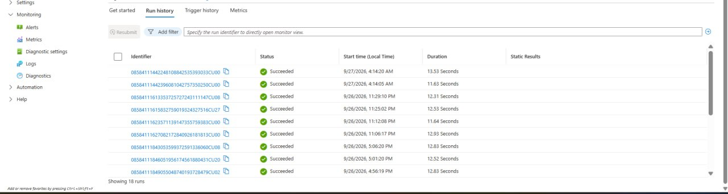
STEP 9: Start VM Automation – Successful Run History

Slide 26
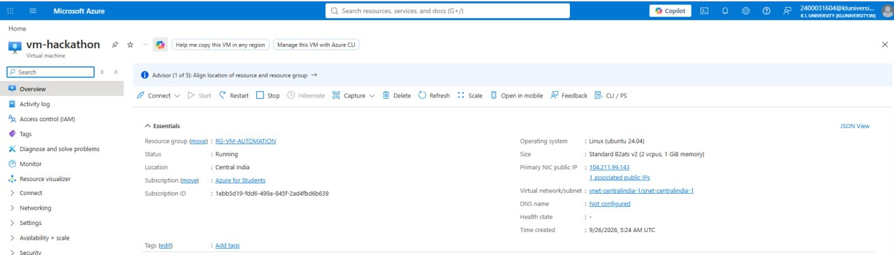
STEP 10: VM Running – Final Verification

Slide 27
COST CONSIDERATIONS, LESSONS LEARNED & FUTURE ENHANCEMENTS
Testing & Validation
  Execute the Start Runbook and verify that the VM starts successfully.
  Execute the Stop Runbook and confirm that the VM is deallocated.
  Verify Managed Identity authentication and permissions.
  Check schedule execution and job history.
Challenges & Solutions
  Authentication Errors: Configure Managed Identity correctly.
  Permission Issues: Assign appropriate Azure RBAC roles.
  Missing PowerShell Modules: Install required Az modules.
  Schedule Failures: Verify schedule settings and runbook publication.

Slide 28
CONCLUSION
  Successfully designed a solution to automate Azure Virtual Machine start and stop schedules using Azure Automation Runbooks.
  Reduced the need for manual VM management and helped optimize cloud resource usage.
  Implemented scheduled execution using PowerShell runbooks and Managed Identity for secure access.
  Improved operational efficiency and demonstrated how automation can help reduce unnecessary cloud costs.

Slide 29
THANK YOU

